Slide 1
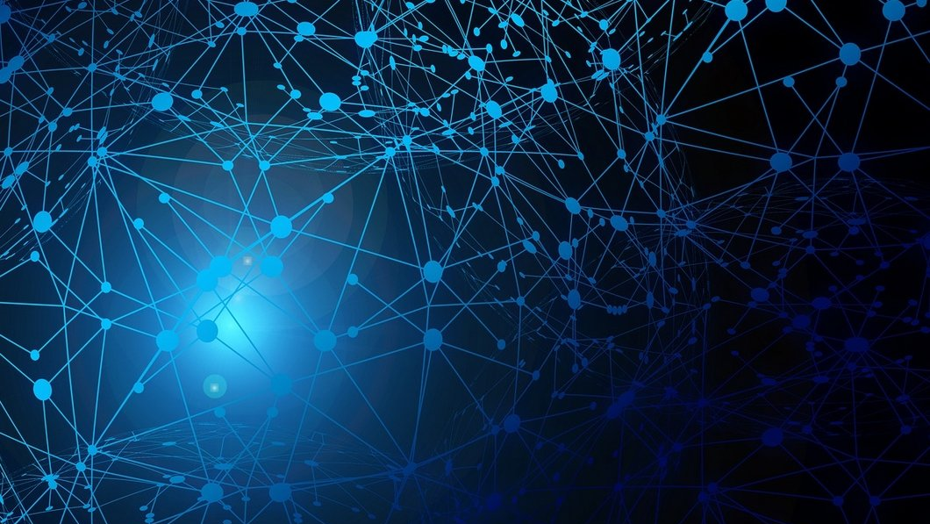
Classification with Meta-Learning
Emmanouil KOUTOULAKIS​
Emmanouil Markodimitrakis​
Yağmur çiğdem aktaş​

Slide 2



Workflow
Compare the proposed method with other SOTA methods
Research
SOTA meta-learning papers with high citations
Explore
meta-learning approaches
Select
a paper based on the citations
Insights
Study the paper and find the most important details
Implement
the Meta-Learning model using a Deep Learning framework (Tensorflow or PyTorch)
Evaluate
Evaluate the model, using proposed metrics
Compare

Slide 3
Explore meta-learning approaches
There are three common approaches^{[8]}
Using (cyclic) networks with external or internal memory (model-based)
Learning effective distance metrics (metrics-based)
Explicitly optimizing model parameters for fast learning (optimization-based).

Slide 4
Research SOTA Meta-Learning Papers
We ordered the outputs of databases according to the citation score and the publication date
We selected the most recent approaches about Meta Learning in the following citation databases
Search criteria: “Meta learning” AND “Covid” AND “Diagnosis”
Literature Data-bases | Search Results
Science Direct | 4
Google Scholar | 358
PubMed | 3
Sum | 365

Slide 5
Select a paper based on the citations
Publication | Citations | Title
[1] M. Shorfuzzaman, Μ. S. Hossain | 40 | MetaCOVID: A Siamese neural network framework with contrastive loss for n-shot diagnosis of COVID-19 patients
[2] T. Naren, Y. Zhu et al. | 0 | COVID-19 diagnosis using model agnostic meta-learning on limited chest X-ray images
[3] R. Singh, V. Bharti, et al. | 0 | MetaMed: Few-shot medical image classification using gradient-based meta-learning
[4] W. Zheng, L Yan, et al. | 2 | Learning to learn by yourself: Unsupervised meta‐learning with self‐knowledge distillation for COVID‐19 diagnosis from pneumonia cases

Slide 6
Insights
Datasets
Siamese Neural Network Architecture
Loss Functions
Training Strategy & Optimizer
Evaluation metrics

Slide 7
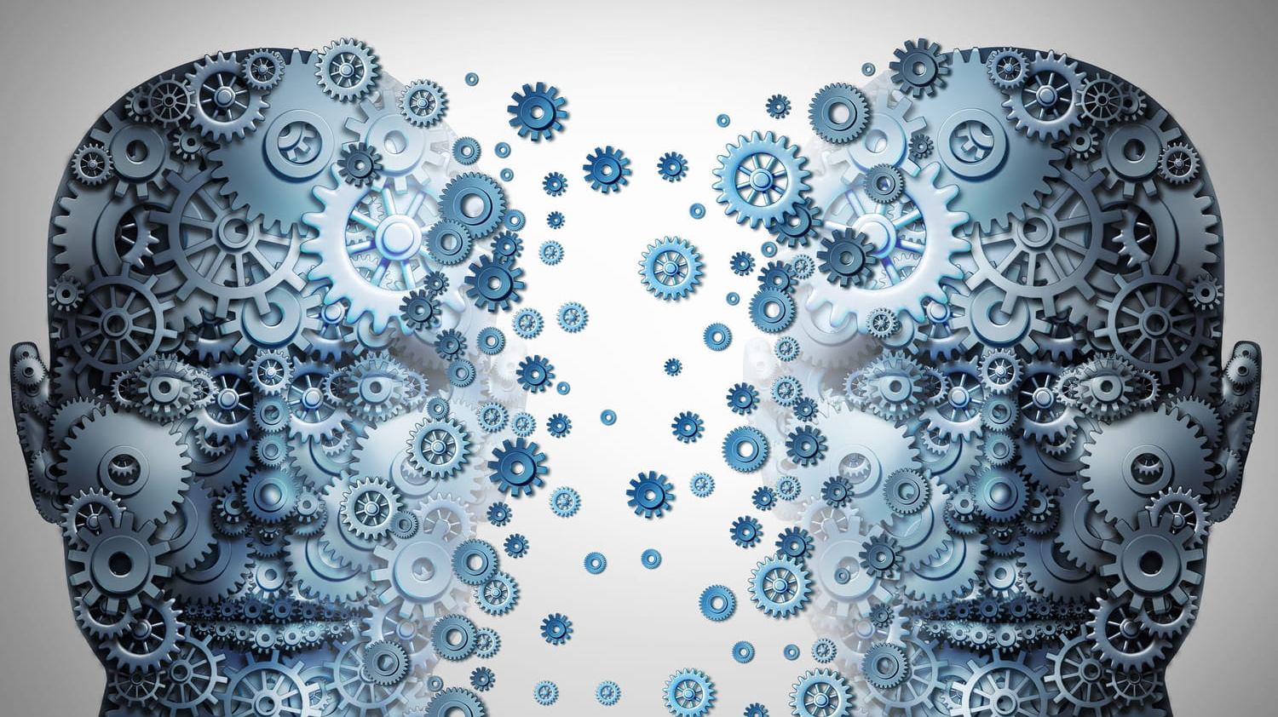
Implement the Meta-Learning model
Transfer learning - VGG

Slide 8
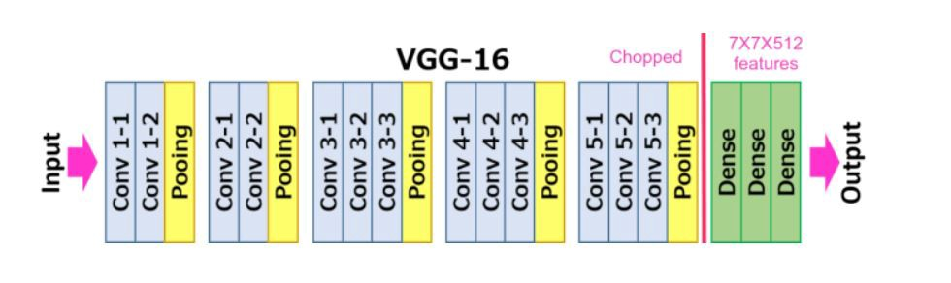
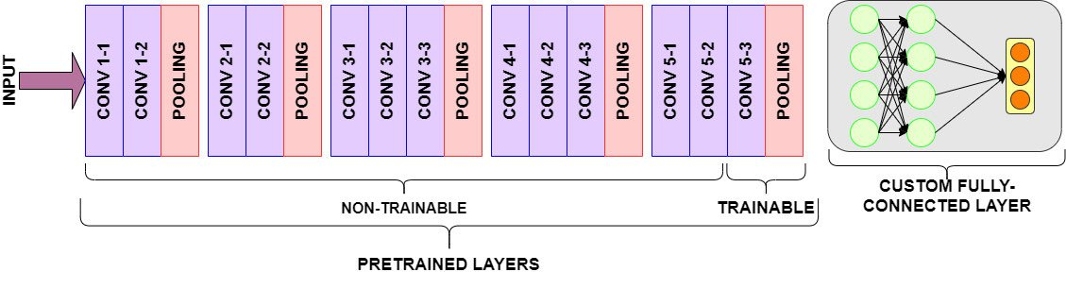
Transfer learning - VGG

Slide 9

MetaCovid - A Siamese neural network framework with contrastive loss for n -shot diagnosis of COVID-19 patients
The Goal of the Paper
Dataset
Siamese Neural Network Architecture
Loss Function and Training Strategy
Experiments & Results

Slide 10
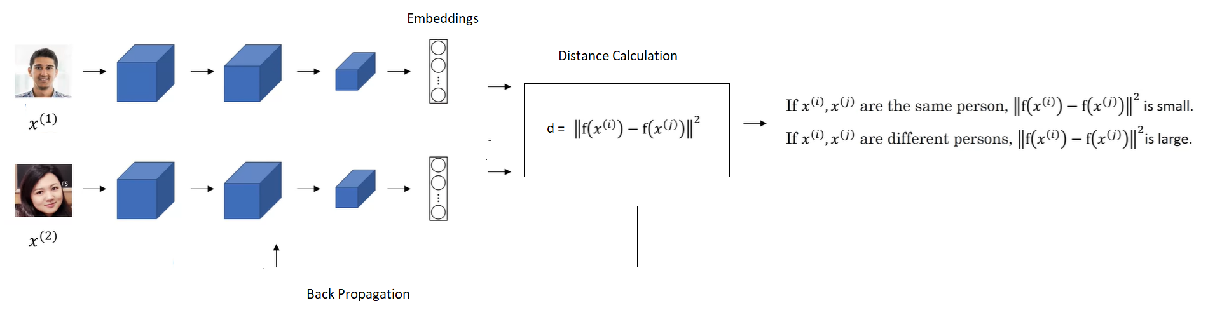
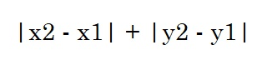
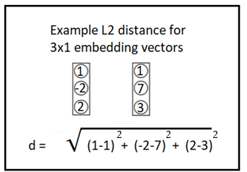
What is Siamese network
L1

Slide 11
Why is it useful?
* No need for big amount of samples for a class while training
* It doesn’t require to retrain the model or any change in the neural network architecture when class number is changed.
Face Recognition model for 3 person in the company
A fourth person get hired
P1
P2
P3
NN
Model doesn’t work anymore!!

Slide 12
The Goal of the Paper
CoronaVirus detection and the methods used for this goal
The disadvantages of the other related works
Presentation of the method that this paper uses for COVID detection

Slide 13
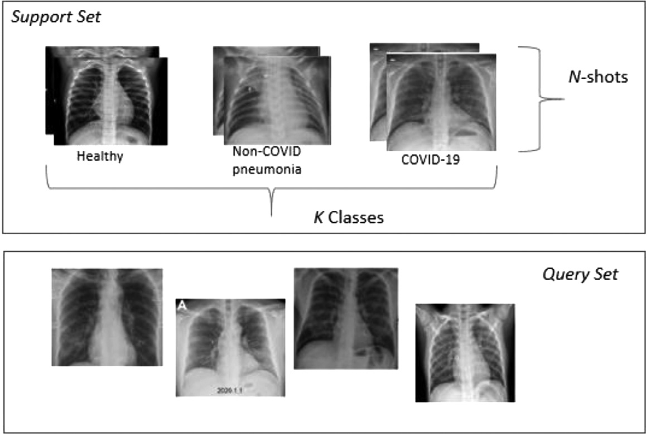
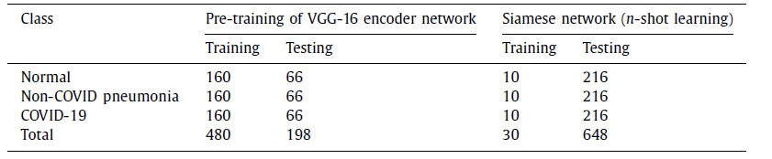
Dataset
CXR (chest x-ray) images from open source database created by Dr. Joseph Cohen which includes COVID-19 examples and a Kaggle repository of CXR images of pneumonia and healthy patients
Classes:
Healthy
Non-Covid Phenomenia
COVID images

Slide 14
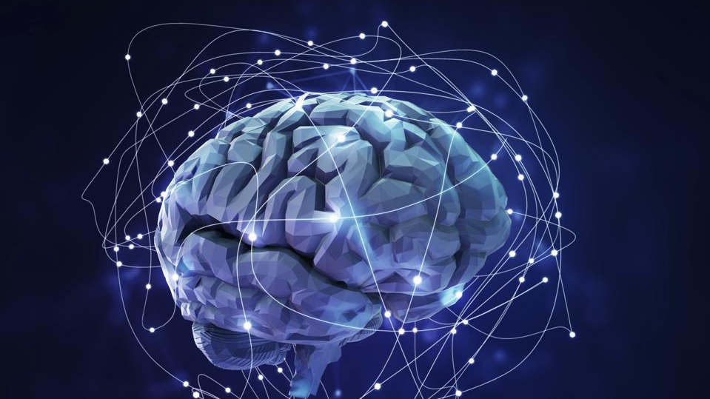
Siamese Neural Network Architecture for MetaCovid
Pre-trained vs Custom CNNs
Architecture
Energy function

Slide 15
Pre-trained CNN vs Custom CNN
Custom Network
Small
Computationally efficient
Requires large training data to produce rich feature encoding
Pre-trained Network
Less training time
Requires small training data
"Hence, we have used a ﬁne-tuned pre-trained VGG-16 [1] on large ImageNet [2] data as base encoder to obtain feature embeddings from the input images to ultimately compute similarity among them."

Slide 16
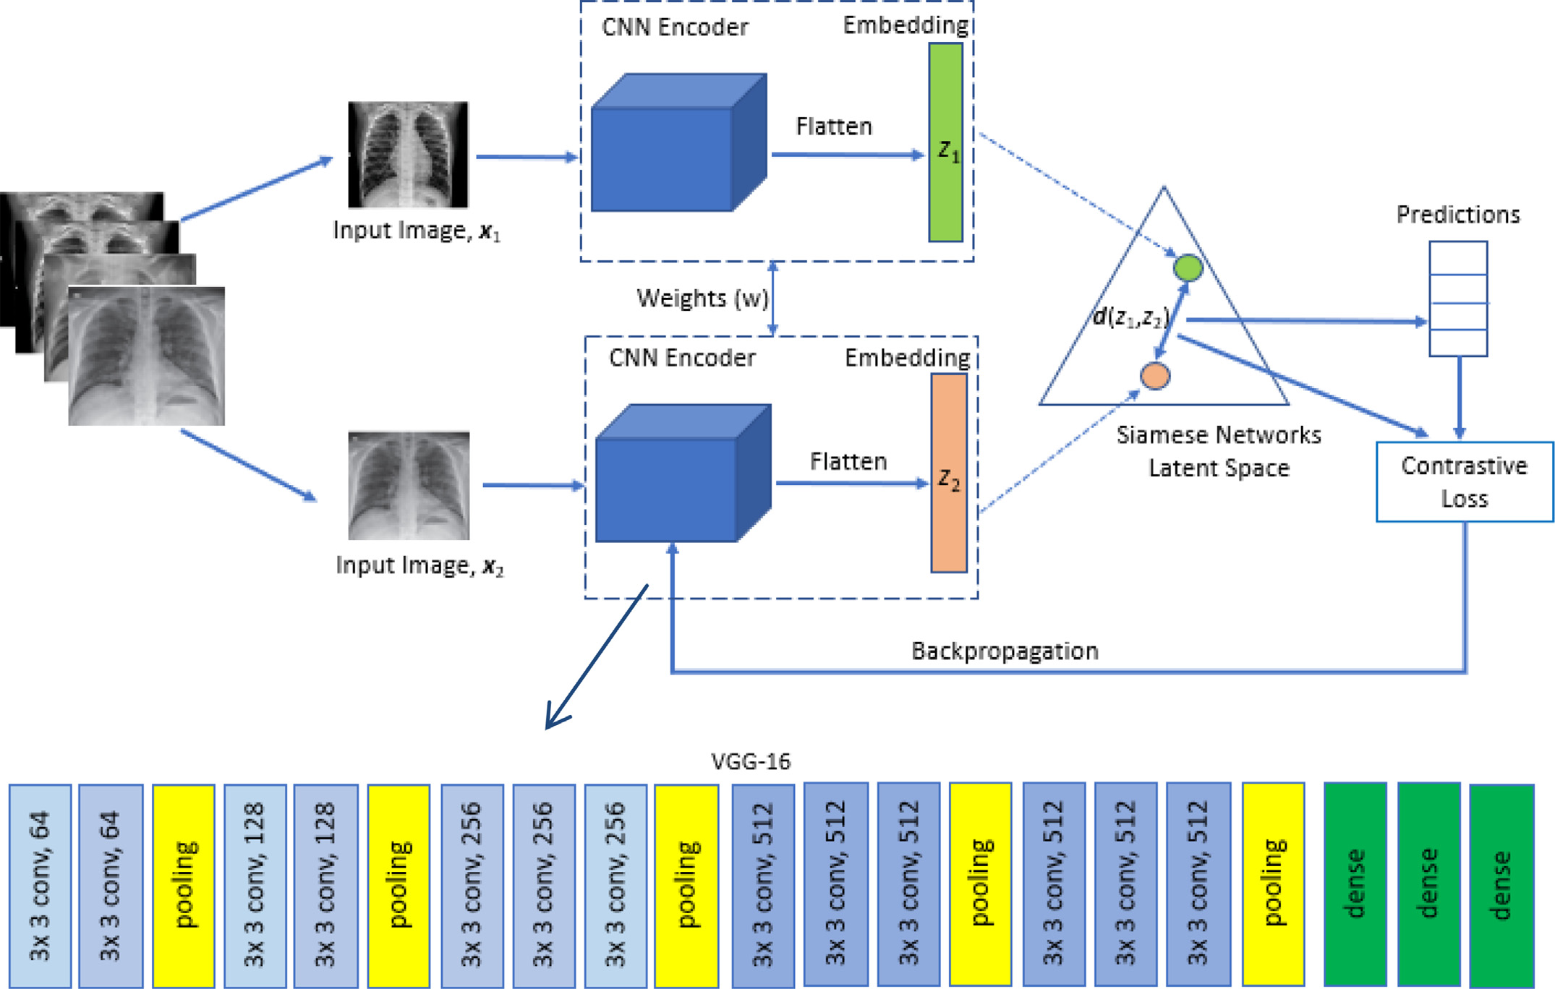
Architecture
Two identical parallel VGG-16 networks
Sharing the same weights and architecture
Different input images
Combine the output to make the final prediction
Learn a function to produce the similarity output between these two images​
Notes:
A convolutional neural network is used to extract the features from two images and ﬁnds the similarity by computing the distance between features of these two images.

Slide 17
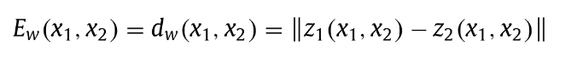
Energy Function
Feature embedding of x₁ denoted as z₁(x₁), this is the output generated from the average pooling layer.
We get a different feature embedding z₂(x₂) for the second input image.
Energy function will give us the similarity between the two inputs.
Distance value can be incorporated in loss function to tune the base encoder through back propagation for improved feature embeddings.
Notes:
In the latent space of feature embeddings, we feed these two embeddings to an energy function which will give us the similarity between the two inputs.
The value of E will be smaller if the input images ( x 1 and x 2 ) are similar and vice versa.

Slide 18
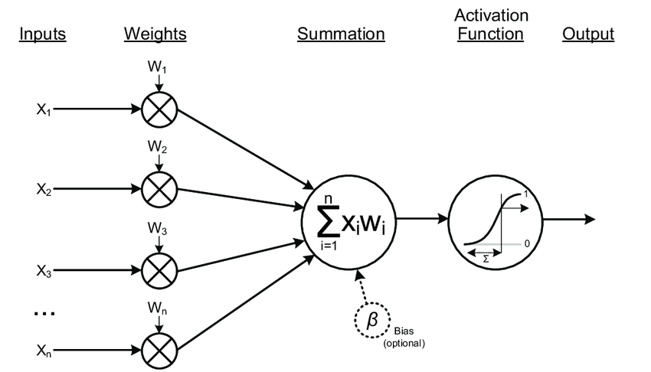
Distance to Probability
distance
probability
sigmoid activation
feedforward linear layer
Notes:
A feedforward linear layer and sigmoid activation function are used to convert the distance to a probability, p , which indicates whether the input images belong to the same target class or not.

Slide 19
Loss Function and Training Strategy
​Contrastive Loss function​
Binary cross entropy​
​Training Algorithm

Slide 20
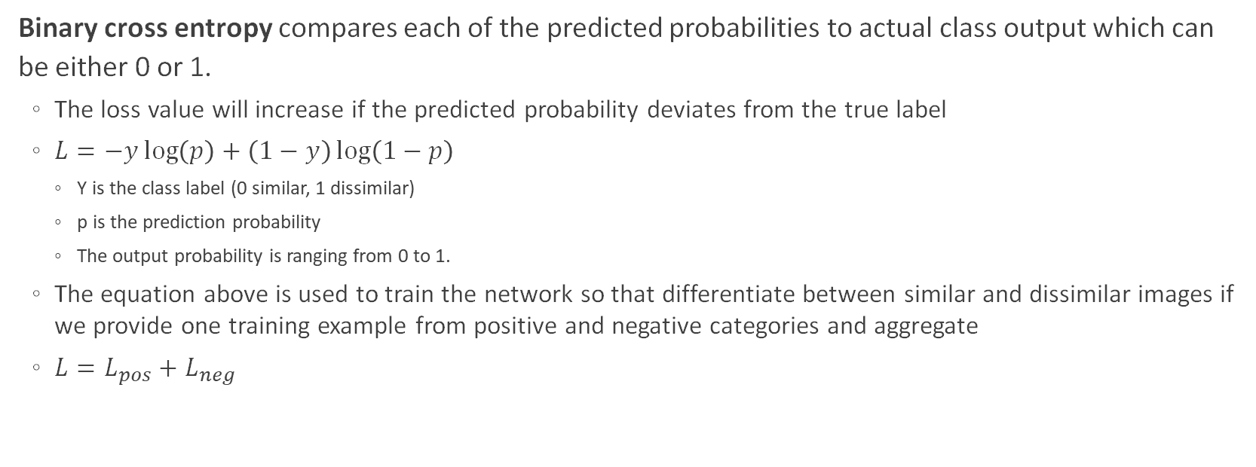
Binary cross entropy
Binary cross entropy compares each of the predicted probabilities to actual class output which can be either 0 or 1.
The loss value will increase if the predicted probability deviates from the true label
$L=−y\log\left(p\right)+\left(1−y\right)\log\left(1−p\right)$
Y is the class label (0 similar, 1 dissimilar)
p is the prediction probability
The output probability is ranging from 0 to 1.
The equation above is used to train the network so that differentiate between similar and dissimilar images if we provide one training example from positive and negative categories and aggregate
$L=L_{pos}+L_{neg}$
Notes:
The probability is ranging from 0 to 1.

Slide 21
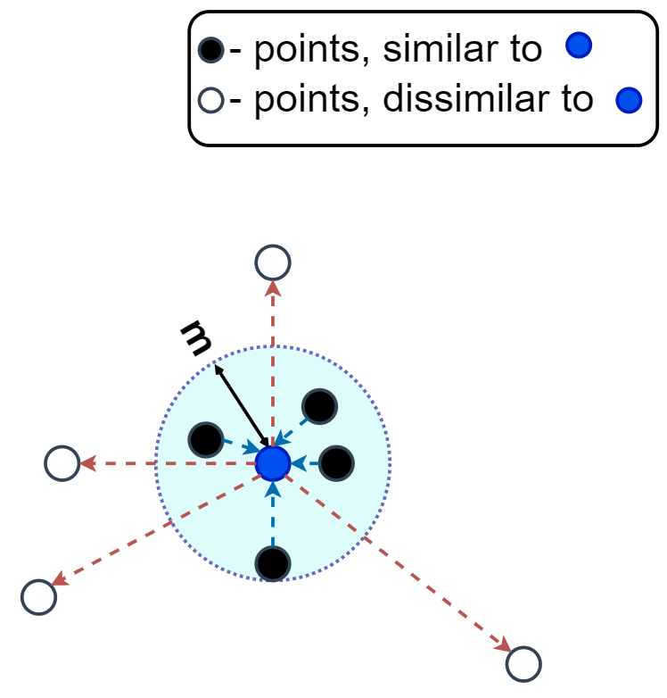
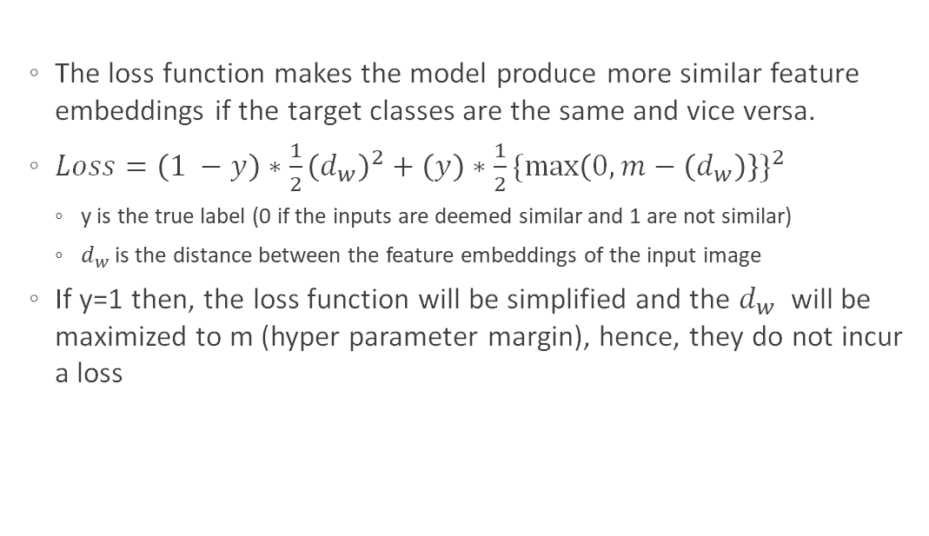
Contrastive Loss function [3]
The loss function makes the model produce more similar feature embeddings if the target classes are the same and vice versa.
$Loss=\left(1 −y\right)∗\frac{1}{2}{\left(d_{w}\right)}^{2}+\left(y\right)∗\frac{1}{2}{\{\max\left(0,m−\left(d_{w}\right)\right\}\}}^{2}$
y is the true label (0 if the inputs are deemed similar and 1 are not similar)
$d_{w}$ is the distance between the feature embeddings of the input image
If y=1 then, the loss function will be simplified and the $d_{w}$ will be maximized to m (hyper parameter margin), hence, they do not incur a loss
Notes:
CL function is a metric-learning loss funaction
The objective of this function is to predict relative distances between inputs.
It operates on pairs of embedding receives from the model and on the ground truth similarity flag
It compares whether these two samples are similar or dissimilar
M is the margin which is a hyperparameter. Margin defines a radious around the embedding space of a sample

Slide 22
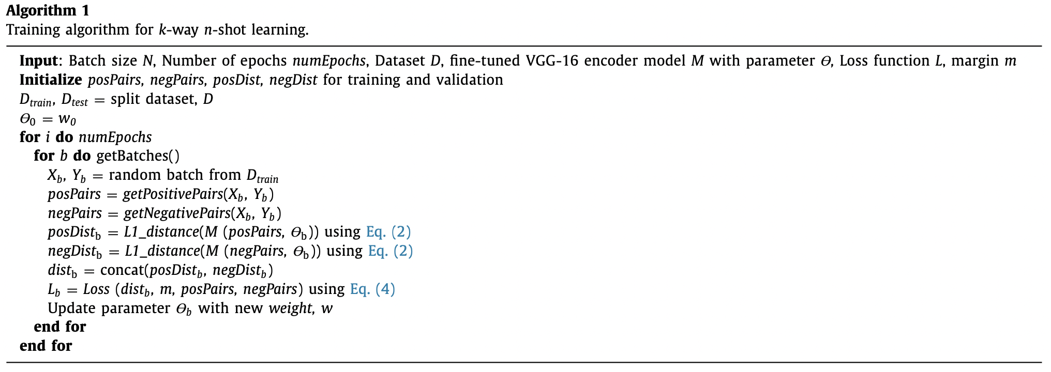
Training Algorithm
Notes:
As we mentioned, we have a k-way, n-shot classification problem for classifying CXR images
We have the dataset D which is decomposed in D_train for training and D_test for testing.
For the training set will contain n samples from each k classes, hence, totaling k*n examples in D_train and D_test consists of several samples for evaluation.
We train our model in episodic fashion. So, over series of episodes, this model will learn how to learn from smaller datasets.

Slide 23
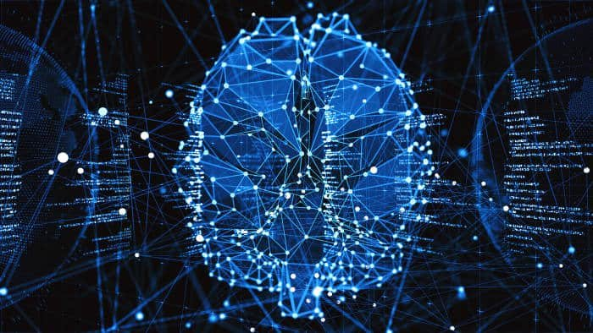
Experiments & Results
Pre-processing
Experimental settings
Results
Evaluation & Discussion

Slide 24
Pre-processing
Re-scale all images to a size of 100 × 100 pixels
Intensity normalization
Image pixel values from [0, 255] to [0, 1]
Histogram equalization on the input images in all three RGB channels to improve image contrast

Slide 25
Experimental settings
Towards the end of the pretrained model we add:
A flatten layer
Followed by a dense layer with 5120 neurons, sigmoid activation function, and L2 kernel regularizer (with a large number of kernels)
Encodings (feature vectors) of the two input images are generated using this preceding dense layer.
Then, we add a customized layer to compute L1 distance by taking the absolute difference between the encodings
Finally, we add a dense layer with a sigmoid unit to generate the similarity score. We have used both contrastive and binary cross-entropy loss functions for model learning
In addition, Adam optimizer is used for model training and optimizing with an initial learning rate of 0.0001

Slide 26
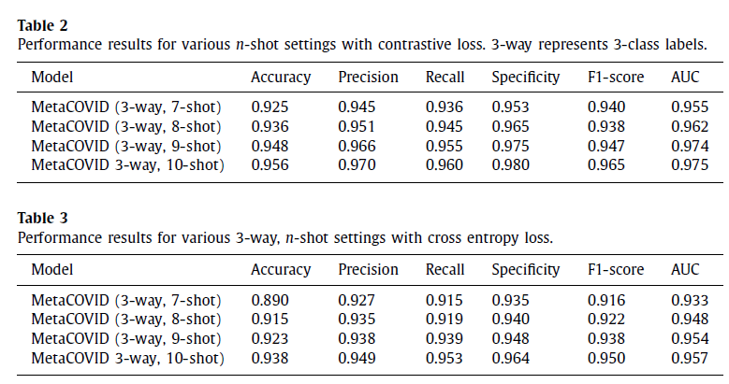
Results (1/3) - Contrastive vs Cross-entropy loss
Generally, the performance results obtained with contrastive loss function seem to be better than the results obtained with cross-entropy loss function.

Slide 27
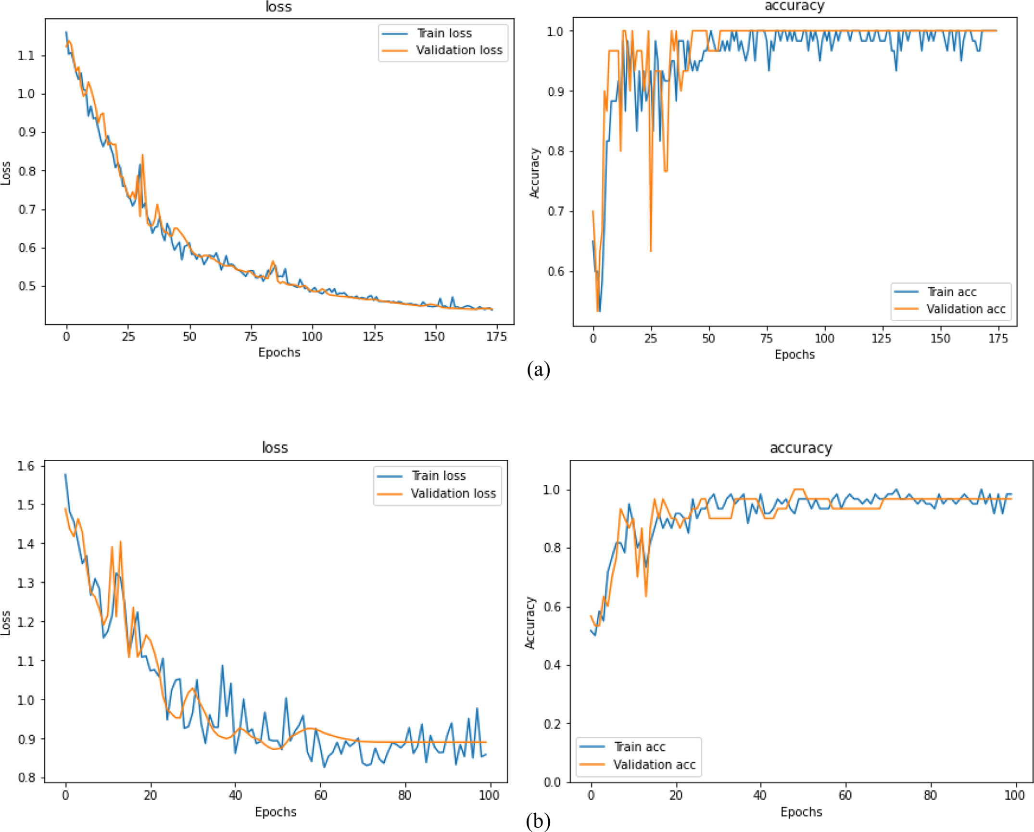
Results (2/3) - Accuracy and loss for 3-way, 10-shot
Contrastive
The model training and validation with contrastive loss function appears to be more stable and further shows better convergence even though with longer training epochs
Cross-entropy

Slide 28
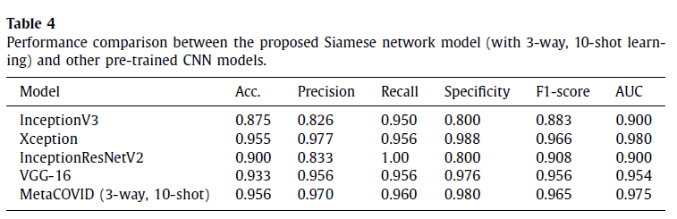
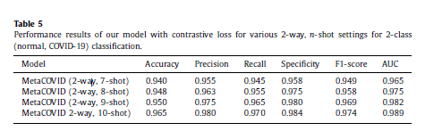
Results (3/3)
The proposed model produces impressive values of sensitivity (96.0%) and speciﬁcity (98.0%) which are deemed to be very critical performance estimates for applications in medical settings

Slide 29
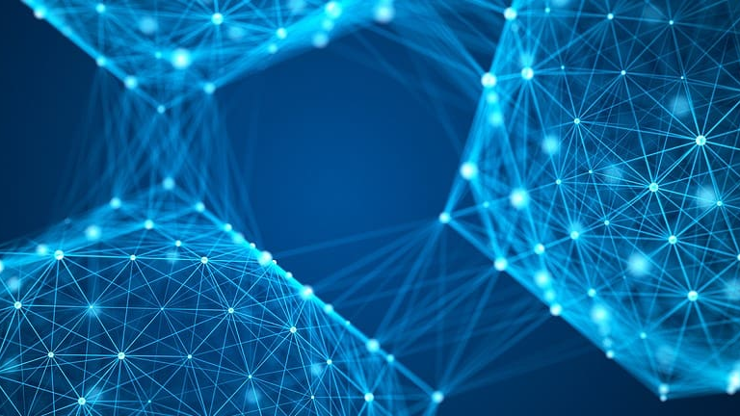
Conclusion & Future Works
The proposed model exhibits comparable or in some cases better performance than the studied fine-tuned pre-trained CNN models.
It is planned to better tackle COVID-19 diagnosis problem as a multi-modal data fusion problem where various types of clinical data such as patient vitals, location, and population density will be used in addition to image data.

Slide 30
Resources
Shorfuzzaman, M., & Hossain, M. S. (2021). MetaCOVID: A Siamese neural network framework with contrastive loss for n-shot diagnosis of COVID-19 patients. Pattern Recognition, 113, 107700. https://doi.org/10.1016/J.PATCOG.2020.107700
Naren, T., Zhu, Y., & Wang, M. D. (2021). Covid-19 diagnosis using model agnostic meta-learning on limited chest X-ray images. Proceedings of the 12th ACM Conference on Bioinformatics, Computational Biology, and Health Informatics. https://doi.org/10.1145/3459930.3469517
Singh, R., Bharti, V., Purohit, V., Kumar, A., Singh, A. K., & Singh, S. K. (2021). MetaMed: Few-shot medical image classification using gradient-based meta-learning. Pattern Recognition, 120, 108111. https://doi.org/10.1016/j.patcog.2021.108111
Zheng, W., Yan, L., Gou, C., Zhang, Z., Zhang, J. J., Hu, M., & Wang, F. (2021). Learning to learn by yourself: Unsupervised meta‐learning with self‐knowledge distillation for COVID‐19 diagnosis from pneumonia cases. International Journal of Intelligent Systems, 36(8), 4033-4064. https://doi.org/10.1002/int.22449
Simonyan, K., & Zisserman, A. (2014). Very Deep Convolutional Networks for Large-Scale Image Recognition. 3rd International Conference on Learning Representations, ICLR 2015 - Conference Track Proceedings. https://arxiv.org/abs/1409.1556v6
Deng, J., Dong, W., Socher, R., Li, L.-J., Kai Li, & Li Fei-Fei. (2010). ImageNet: A large-scale hierarchical image database. 248–255. https://doi.org/10.1109/CVPR.2009.5206848
Hadsell, R., Chopra, S., & LeCun, Y. (2006). Dimensionality reduction by learning an invariant mapping. Proceedings of the IEEE Computer Society Conference on Computer Vision and Pattern Recognition, 2, 1735–1742. https://doi.org/10.1109/CVPR.2006.100

